Slide 1
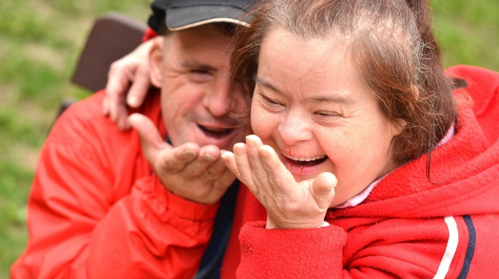
Disabled? How have people with learning disabilities been seen by the societies in which they live?

Slide 2
Lesson 1: Why learn the history of people with learning disabilities?

Slide 3
Lesson 1: What is this enquiry about?
Words
Disability
Vulnerable
Inclusion
Exclusion
Focus questions
What is a learning disability?
Why do some people have learning disabilities?
What makes it difficult to define learning disability?
What makes it difficult to learn about the experiences of
people with learning disabilities who lived in the past?

Slide 4
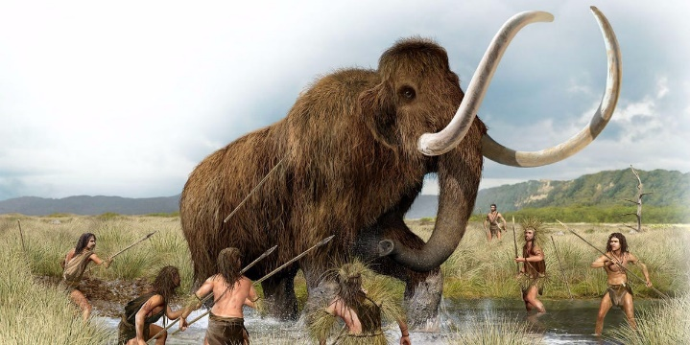
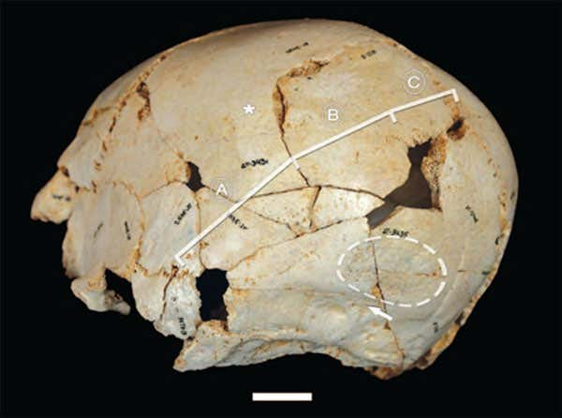
Lesson 2: How far were people with learning disabilities included in the prehistoric period?

Slide 5
Lesson 2: How far were people with learning disabilities included in the prehistoric period?
Words
Prehistoric
Craniosynostosis
Congenital
Focus questions
When was the prehistoric period?
Why might a learning disability been a problem for people living at this time?
What does the skull with craniosynostosis suggest about how people with learning disabilities may have been included in prehistoric communities?

Slide 6
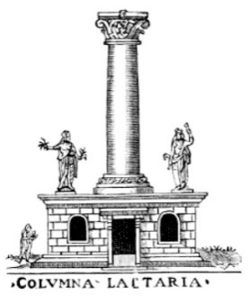
Lesson 3: Did Ancient Societies exclude people with learning disabilities?

Slide 7
Lesson 3: Did ancient societies exclude people with learning disabilities?
Words
Divine
Tolerant
Expose(ure)
Infanticide
Focus questions
What did Ancient Greece laws say should happen to ‘imperfect’ babies?
Why might people considered to have learning disabilities today not been noticed in ancient societies?
What caused attitudes towards disability to change?

Slide 8
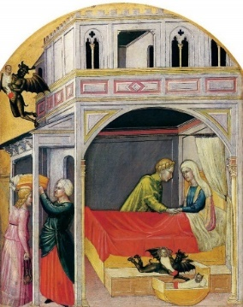
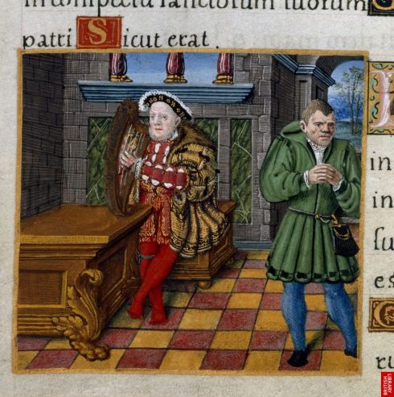
Lesson 4: How fully were people with learning disabilities included in medieval and early modern society?

Slide 9
Lesson 4: How fully were people with learning disabilities included in medieval and early modern society?
Words
Idiot
Monarch
Guardian
Innocent Fool
Natural Fool
Institutionalised
Changeling
Focus questions
Why did people in medieval society believe people with disabilities should be included in society?
Where did most people with learning disabilities live?
What did people believe a changeling was?
Why did rich nobles adopt ‘innocent’ or ‘natural’ fools?
What evidence is there they were meaningfully included?

Slide 10
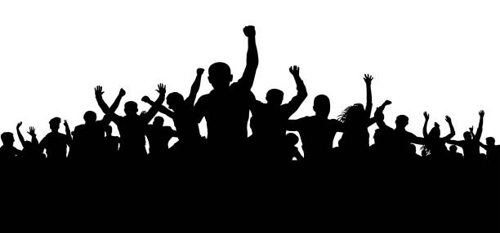
Lesson 5: What do Fanny and Thomas’ stories reveal about how far people with learning disabilities were included in 18th century society?

Slide 11
Lesson 5: What do Fanny and Thomas’ stories reveal about how far people with learning disabilities were included in 18th century society?
Words
Conspirator
Reluctant
Annulled
Alibis
Perjury
Collude
Focus questions
Why did Bowerman wish to marry Fanny Furst?
How do we know her mother cared for her?
What did the legal system do?
Why had Fanny’s mother been reluctant to have her declared a legal idiot?
Did Thomas take part in the riot?
Why did his friends and family lie to protect him?
Why was Thomas released back to his community?

Slide 12
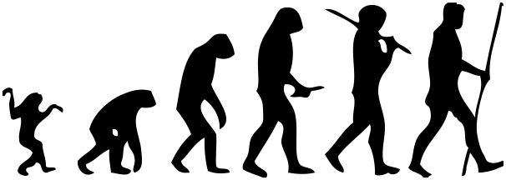
Lesson 6: Why did 19th and 20th century societies lock away people with learning disabilities?

Slide 13
Lesson 6: Why did 19th and 20th century societies lock away people with learning disabilities?
Words
Hierarchical
Natural selection
Great chain of being
Evolution
Unimprovable
Inferior
Asylum
Colony
Focus questions
Why did Charles Darwin’s ideas lead to more exclusionary attitudes towards people with learning disabilities?
Where were people with learning disabilities increasingly placed?
Why did incarceration make people with learning disabilities more vulnerable?

Slide 14
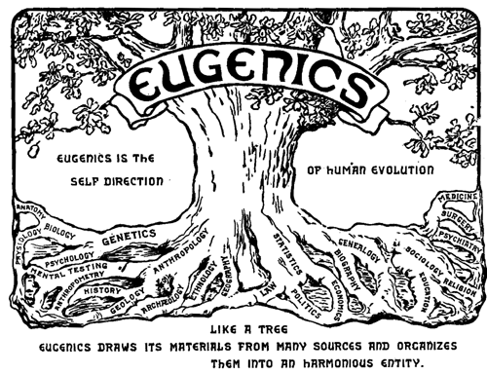
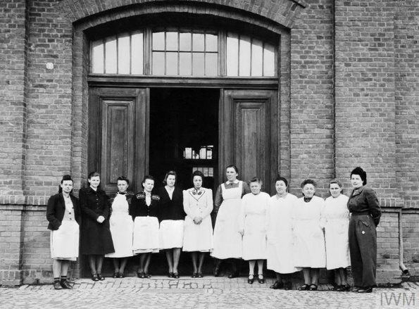
Lesson 7: Why did some societies in the 20th century try to get rid of people with learning disabilities?

Slide 15
Lesson 7: Why did some societies in the 20th century try to get rid of people with learning disabilities?
Focus questions
What did Eugenic Societies aim to do?
Why was there growing belief people with learning disabilities should not exist?
What happened to people with learning disabilities in Germany?
How did the discovery of what happened in Germany end mainstream support for eugenics?
Words
Eugenics
Urbanised
Sterilisation
Condolence
Propaganda
Discredited

Slide 16
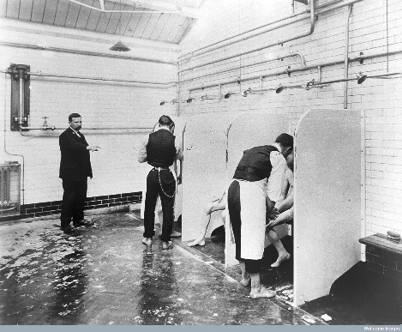
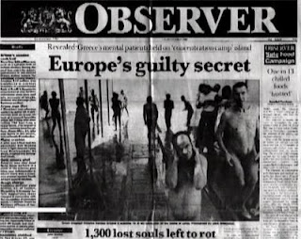
Lesson 8: Back in the community? – how included are people with learning disabilities now?

Slide 17
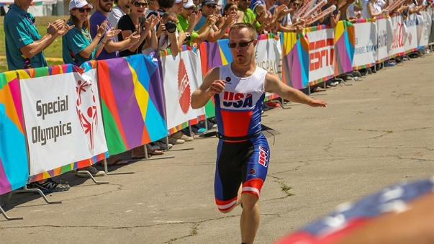
Lesson 8: Back in the community? – how included are people with learning disabilities now?

Slide 18
Lesson 8: Back into the community – how included are people with learning disabilities now?
Words
Ineducable
Scandal
Lurk
Focus questions
Why did conditions in NHS hospitals for people with learning disabilities shock the public?
Why were some children with learning disabilities refused education?
Why did attitudes begin to change?
What evidence is there that people with learning disabilities are still not fully included in society?

